Slide 1
Aging effects in Schelling Segregation Model
DAVID ABELLA-BUJALANCE, MAXI SAN MIGUEL, AND JOSE J. RAMASCO
Instituto de Física Interdisciplinar y Sistemas Complejos IFISC (CSIC-UIB), Campus UIB, 07122 Palma de Mallorca, Spain

Slide 2


Schelling Model
1/9
Schelling Model (1971)
Thomas C. Schelling (1971), The Journal of Mathematical Sociology, 1:2, 143-186
From US Census (bestneighbourhood.com)

Slide 3
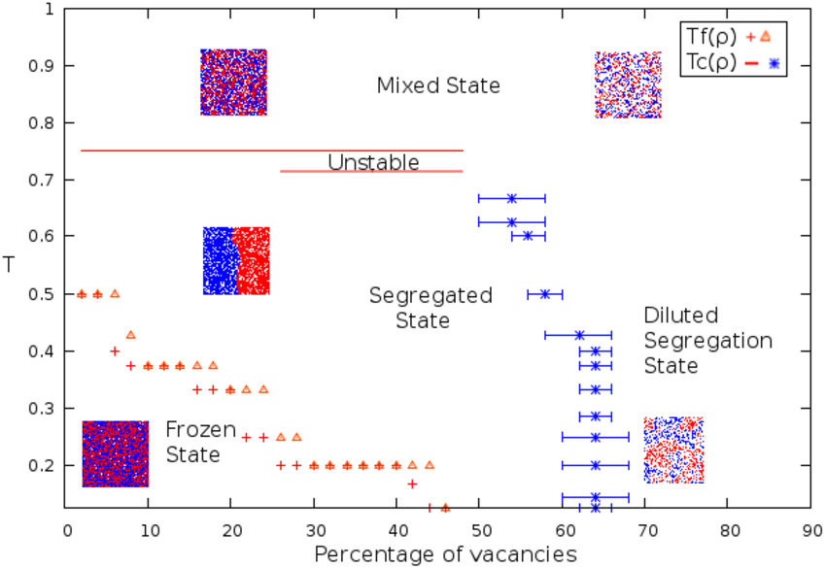

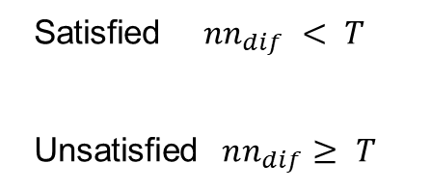
Schelling Model
1/9
1/9
Schelling Model (1971)
Thomas C. Schelling (1971), The Journal of Mathematical Sociology, 1:2, 143-186
From US Census (bestneighbourhood.com)
Noisy Constrained Schelling Model (NCSM)
by Gauvin et. al. (2009).
Two agent states:
$$T=1/2$$
Satisfied $nn_{dif} < T$
Unsatisfied $nn_{dif}≥ T$
X
X
All agents move (with long-range) to satisfying vacancies
Gauvin, L et. al. Eur. Phys. J. B 70, 293–304 (2009).

Slide 4
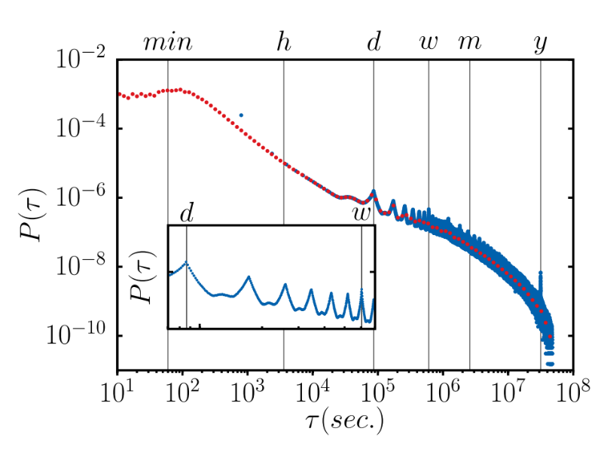
Aging effects
2/9
2/9
The assumption that events occur at a constant rate is often used for stochastic modelling.
There is empirical evidence from phone and online communication that the human interactions show activity patterns that are described by interevent flat-tail distributions.
Oriol Artime, et. al. Phys. Rev. E 98, 032104 (2018)

Slide 5


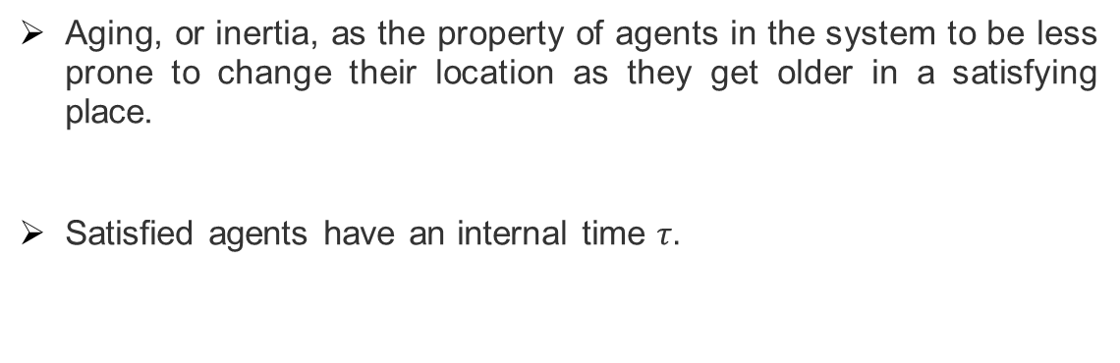
Aging effects
2/9
2/9
The assumption that events occur at a constant rate is often used for stochastic modelling.
There is empirical evidence from phone and online communication that the human interactions show activity patterns that are described by interevent flat-tail distributions.
Oriol Artime, et. al. Phys. Rev. E 98, 032104 (2018)
Aging, or inertia, as the property of agents in the system to be less prone to change their location as they get older in a satisfying place.
Satisfied agents have an internal time $τ.$
Activation probability:
$$p\left(τ\right)=\frac{1}{τ+2}$$
From Disney Pixar Movie UP.

Slide 6
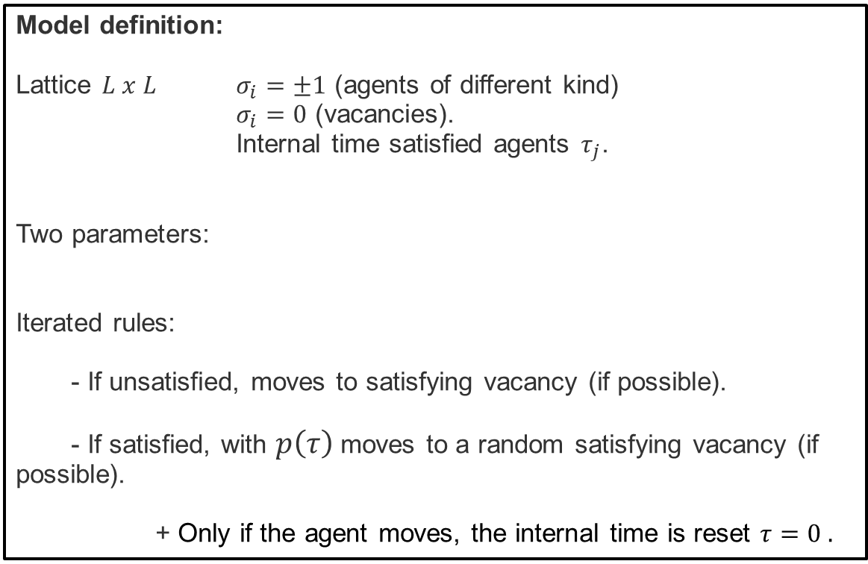


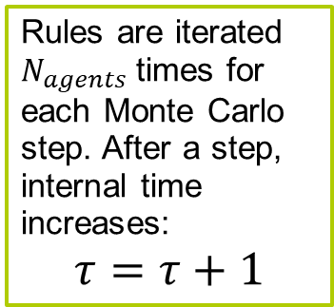
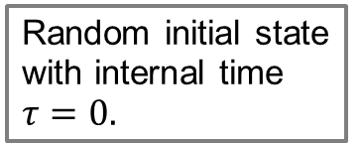
Aging effect in the Noisy Constrained Schelling Model
3/9
3/9
Model definition:
Lattice $L x L$ $σ_{i}=±1$ (agents of different kind)
$σ_{i}=0$ (vacancies).
Internal time satisfied agents $τ_{j}$.
Two parameters:
Iterated rules:
- If unsatisfied, moves to satisfying vacancy (if possible).
- If satisfied, with $p\left(τ\right)$moves to a random satisfying vacancy (if possible).
+ Only if the agent moves, the internal time is reset $τ=0 .$
Rules are iterated $N_{agents}$times for each Monte Carlo step. After a step, internal time increases:
$$τ=τ+1$$
- Vacancy density $ρ_{v}$
- Tolerance $T$
Random initial state with internal time $τ=0.$
Aging is expected to reduce the noisy effect from the satisfied agents movement.

Slide 7
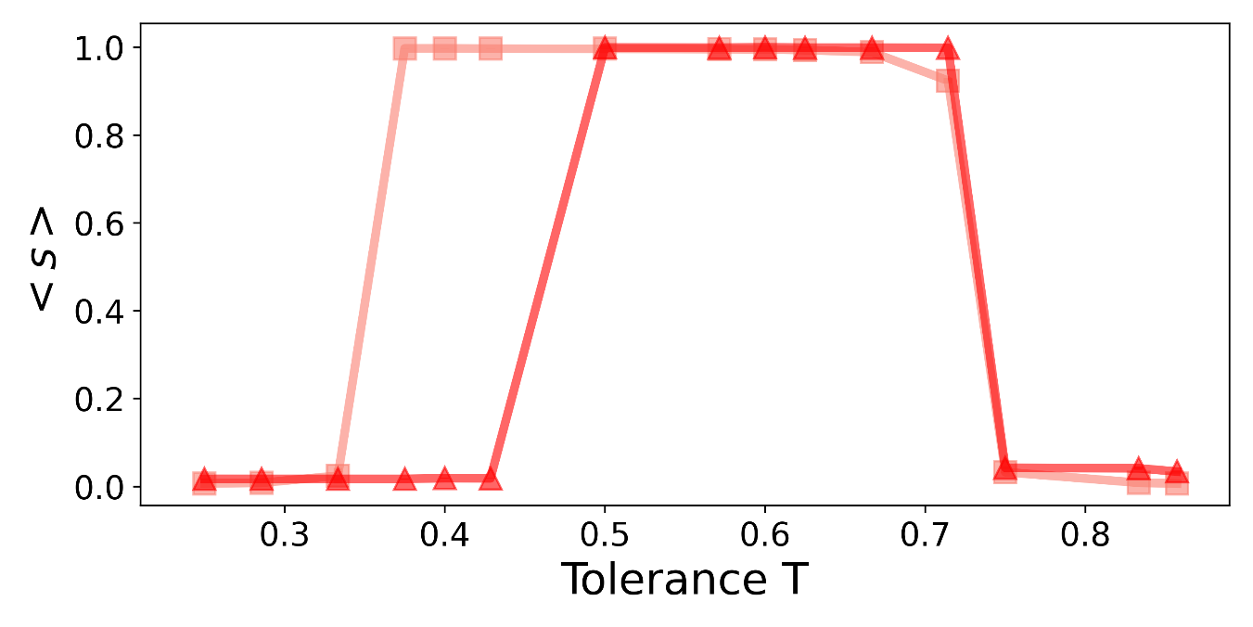
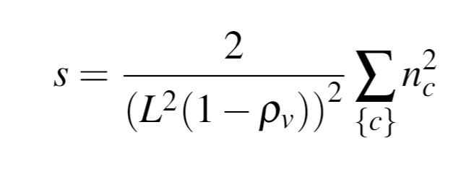



Phase Diagram
NCSM
4/9
4/9
$$ρ_{v}=0.15$$
$$ρ_{v}=0.05$$
$$T_{th}=0.75$$
Segregation coeficient:

Slide 8


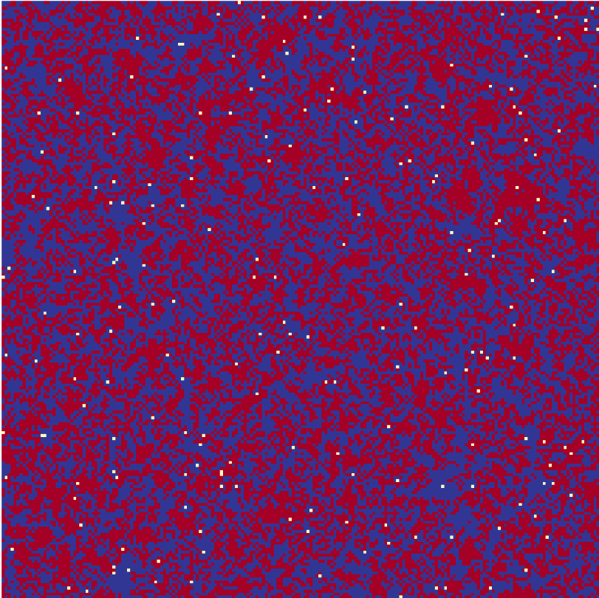
Phase Diagram
NCSM
4/9
4/9
$$ρ_{v}=0.15$$
$$ρ_{v}=0.05$$
$$T_{th}=0.75$$
Segregation coeficient:
MIXED
FROZEN
SEGREGATED

Slide 9
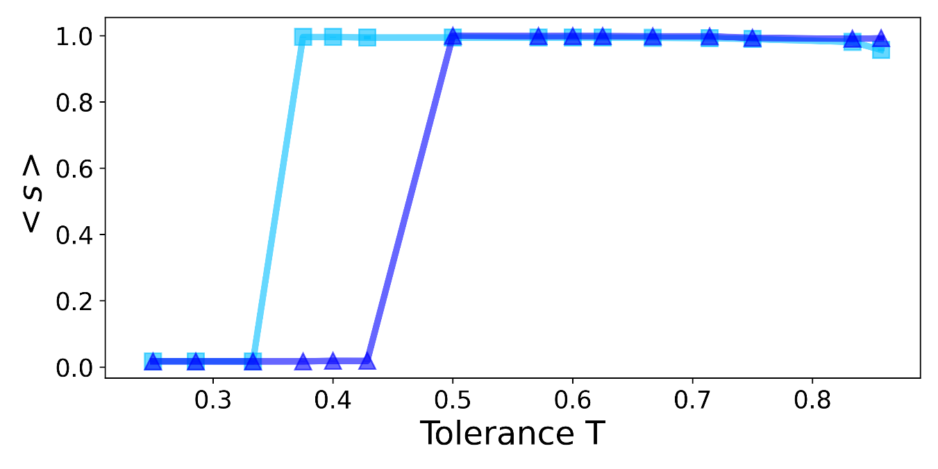

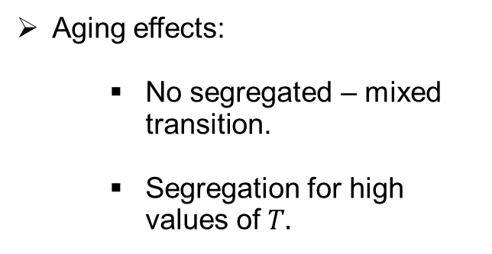

Phase Diagram
NCSM
4/9
4/9
$$ρ_{v}=0.15$$
$$ρ_{v}=0.05$$
$$T_{th}=0.75$$
Segregation coeficient:
MIXED
FROZEN
Aging effects:
  No segregated – mixed transition.
  Segregation for high values of $T.$
SEGREGATED
NCSM with aging
Aging favours segregation!
$$ρ_{v}=0.15$$
$$ρ_{v}=0.05$$

Slide 10
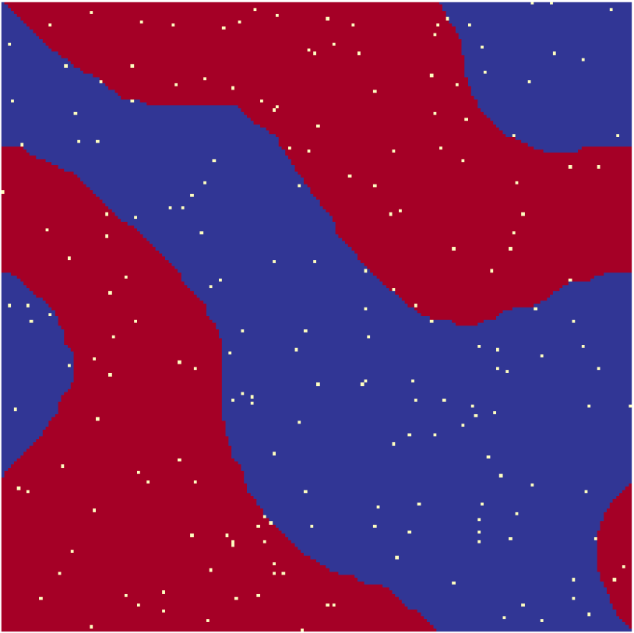
Phase Diagram
NCSM
4/9
4/9
$$ρ_{v}=0.15$$
$$ρ_{v}=0.05$$
$$T_{th}=0.75$$
Segregation coeficient:
MIXED
FROZEN
FROZEN
Aging effects:
  No segregated – mixed transition.
  Segregation for high values of $T.$
SEGREGATED
FROZEN
NCSM with aging
SEGREGATED
Aging favours segregation!
$$ρ_{v}=0.15$$
$$ρ_{v}=0.05$$

Slide 11
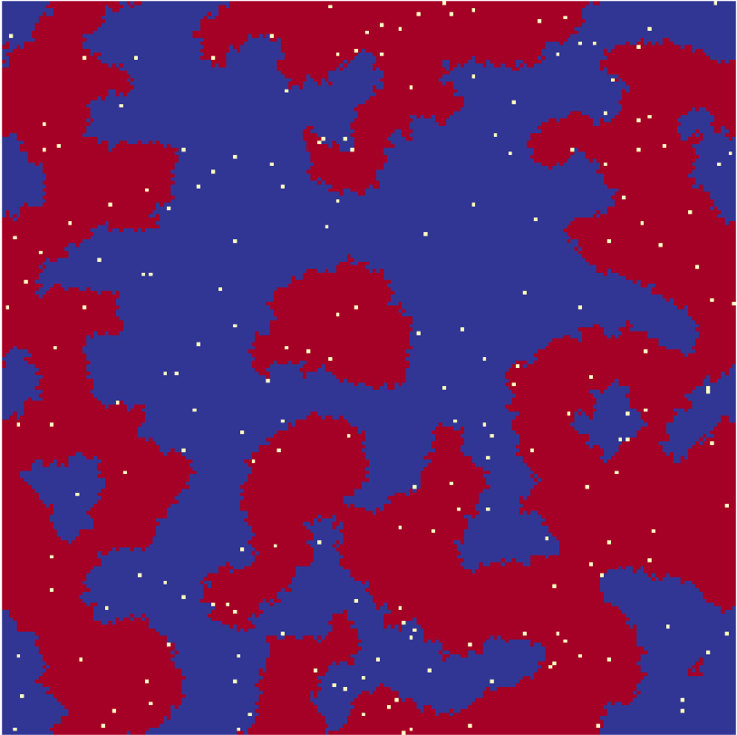
Phase Diagram
NCSM
NCSM
4/9
4/9
$$ρ_{v}=0.15$$
$$ρ_{v}=0.05$$
$$T_{th}=0.75$$
Segregation coeficient:
MIXED
FROZEN
FROZEN
Aging effects:
  No segregated – mixed transition.
  Segregation for high values of $T.$
SEGREGATED
FROZEN
NCSM with aging
NCSM with aging
NCSM with aging
SEGREGATED
Aging favours segregation!
$$ρ_{v}=0.15$$
$$ρ_{v}=0.05$$

Slide 12
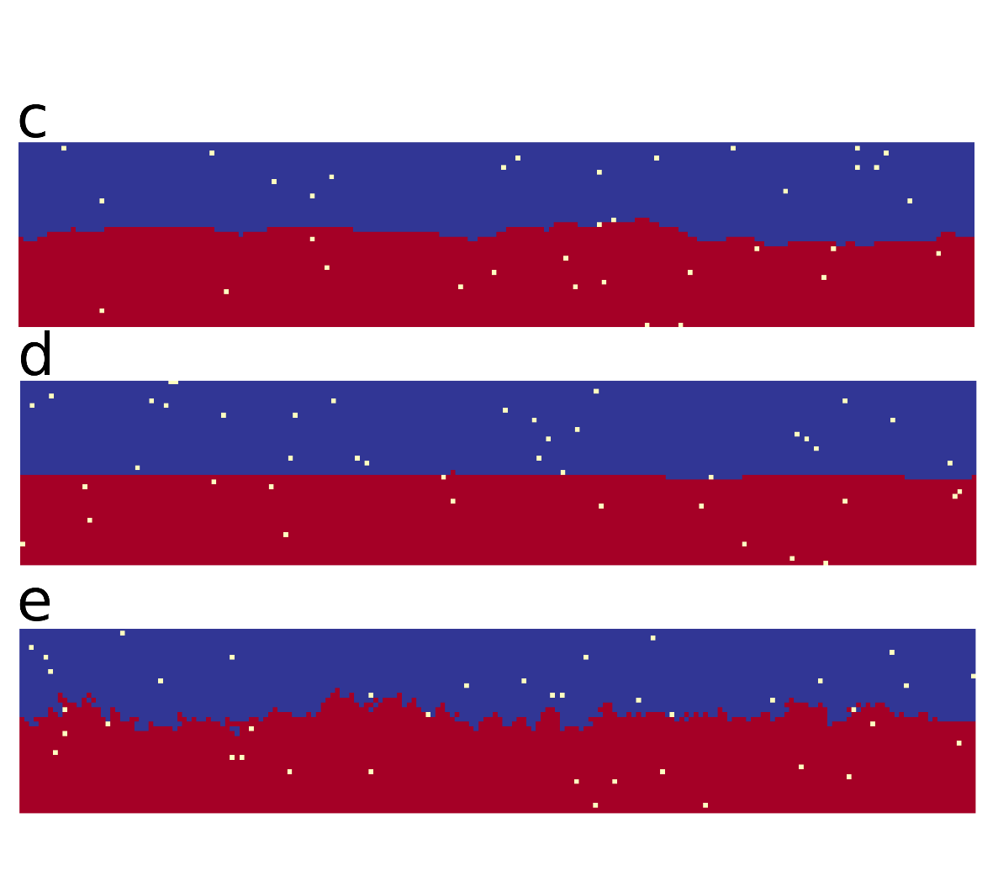
Segregated phase: final state
5/9
With aging,
final segregated state shows diferences for both models:
Soft interface (almost flat)
NC Schelling Model T = 0.57
NC Schelling Model with aging T = 0.57

Slide 13
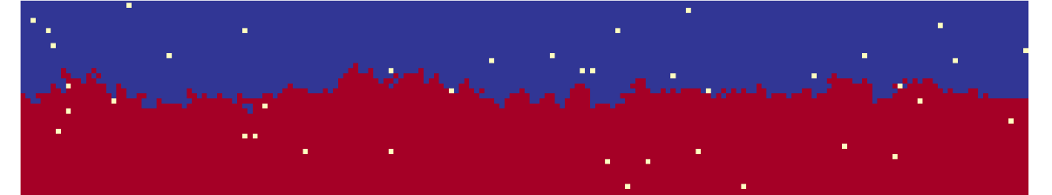

Segregated phase: final state
5/9
With aging,
final segregated state shows diferences for both models:
Soft interface (almost flat)
Rough interface for large $T$
NC Schelling Model T = 0.57
NC Schelling Model with aging T = 0.57
NC Schelling Model with aging T = 0.85

Slide 14
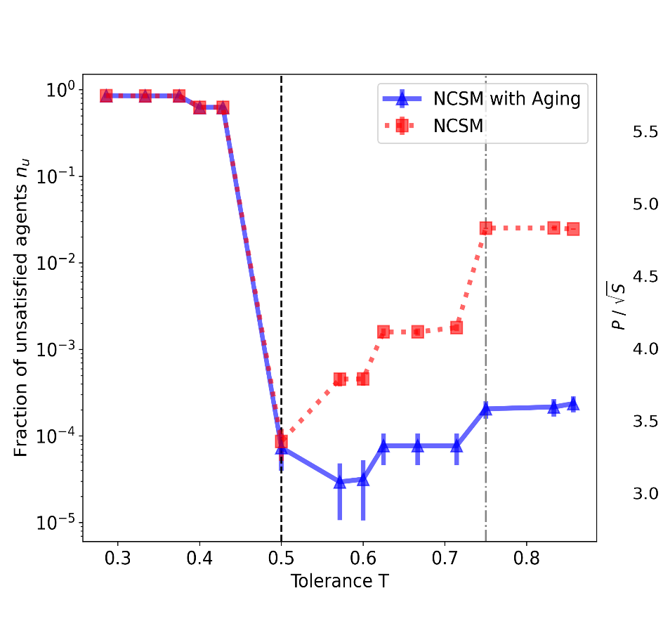

Segregated phase: final state
5/9
With aging,
final segregated state shows diferences for both models:
Soft interface (almost flat)
Rough interface for large $T$
Higher global satisfaction
NC Schelling Model T = 0.57
NC Schelling Model with aging T = 0.57
NC Schelling Model with aging T = 0.85
$$ρ_{v}=0.5\%$$

Slide 15
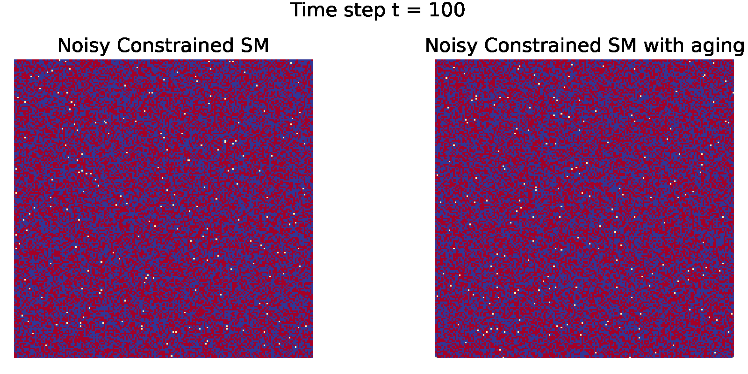
Segregated phase
6/9
$$ρ_{v}=0.5\% T=0.71 L=200$$
Different coarsening towards the final segregated state:

Slide 16
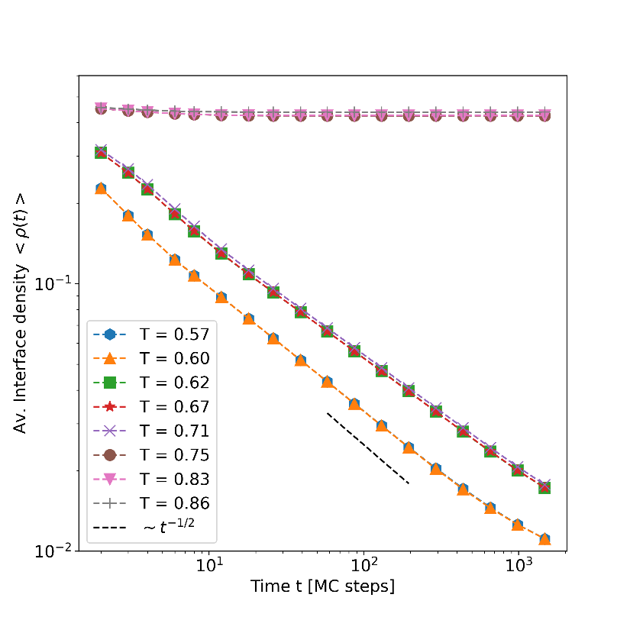
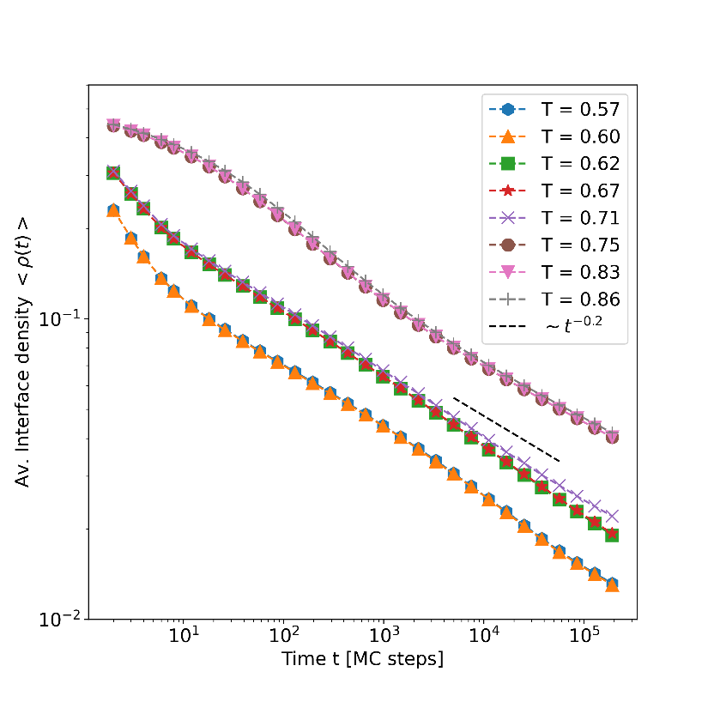



Segregated phase: coarsening dynamics
7/9
NC Schelling Model
NC Schelling Model with aging
$$t^{−0.5}$$
$$t^{−0.2}$$
$$ρ_{v}=0.5\%$$
$$L=200$$

Slide 17
Segregated phase: coarsening dynamics
7/9
NC Schelling Model
NC Schelling Model with aging
$$t^{−0.5}$$
$$t^{−0.2}$$
$$ρ_{v}=0.5\%$$
$$L=200$$

Slide 18
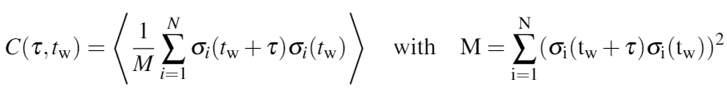
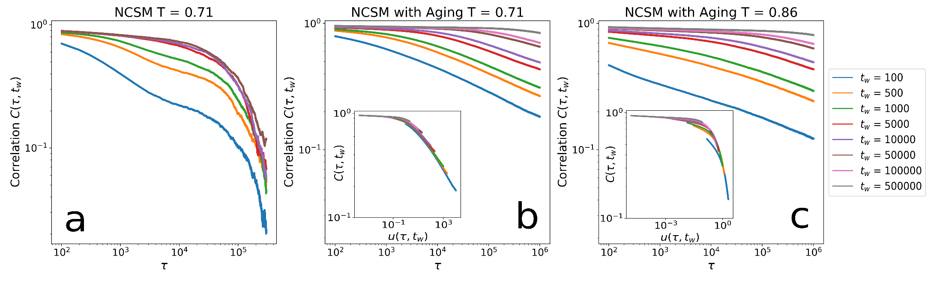




Autocorrelations and time-translational invariance
8/9
Autocorrelations function:
Aging breaks the time-translational invariance.
Different scaling for large $T.$
$\frac{τ}{t_{w}}$
$$\frac{\log\left(t_{w}+ τ\right)}{\log\left(t_{w}\right)}−1$$
$$T_{th}=0.75$$
$$ρ_{v}=0.02$$
$$L=200$$

Slide 19
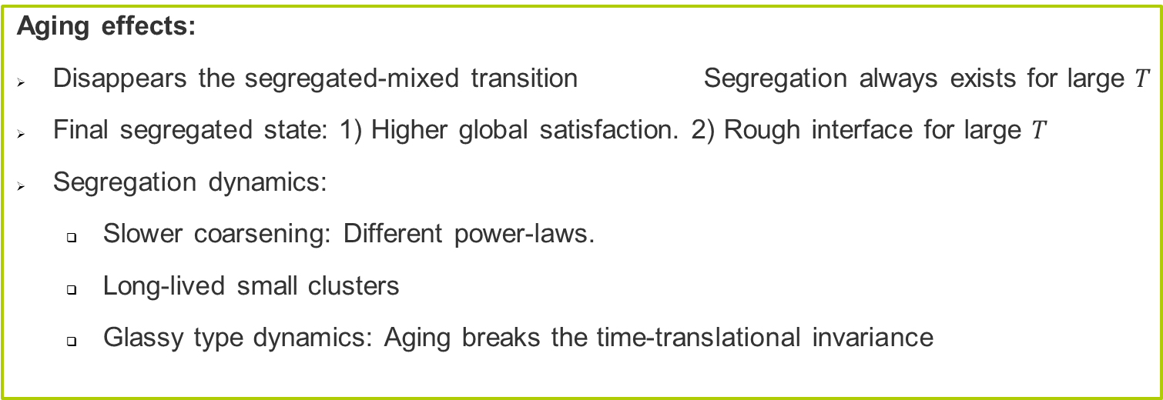
Summary and discussion
9/9
Aging effects:
Disappears the segregated-mixed transition Segregation always exists for large $T$
Final segregated state: 1) Higher global satisfaction. 2) Rough interface for large $T$
Segregation dynamics:
  Slower coarsening: Different power-laws.
  Long-lived small clusters
  Glassy type dynamics: Aging breaks the time-translational invariance

Slide 20
Summary and discussion
9/9
Aging effects:
Disappears the segregated-mixed transition Segregation always exists for large $T$
Final segregated state: 1) Higher global satisfaction. 2) Rough interface for large $T$
Segregation dynamics:
  Slower coarsening: Different power-laws.
  Long-lived small clusters
  Glassy type dynamics: Aging breaks the time-translational invariance
Once again, common sense fails Aging favours segregation.
Segregation for large $T$ Current scenario of Global cities

